Slide 1
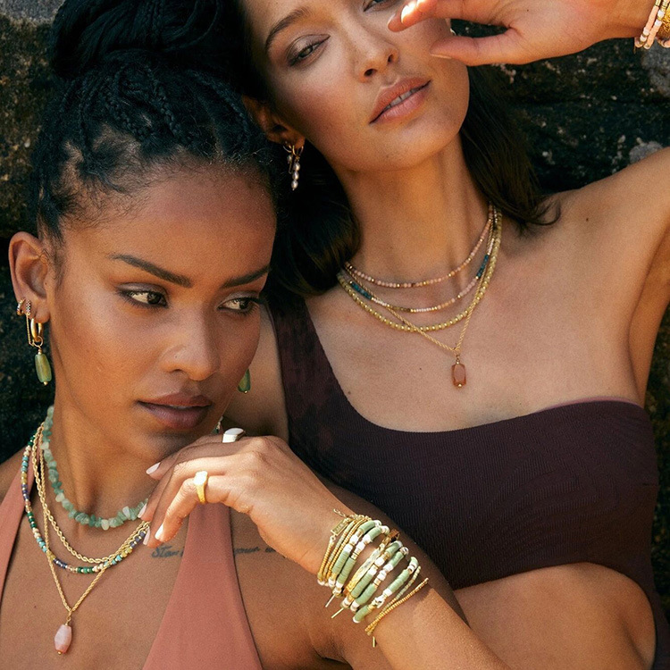
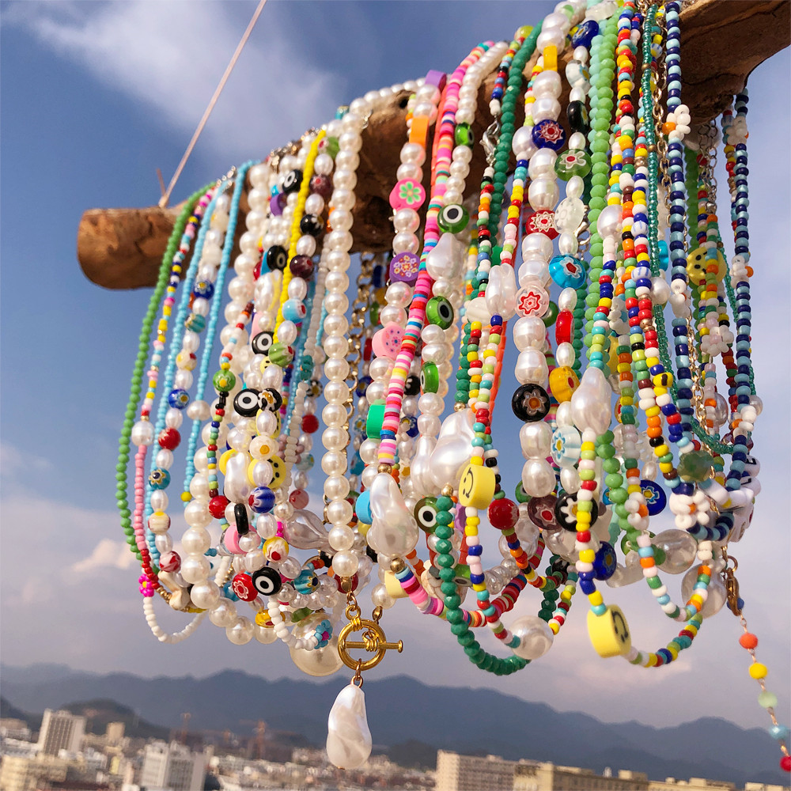
Top-sellers in June
www.nihaojewelry.com/

Slide 2
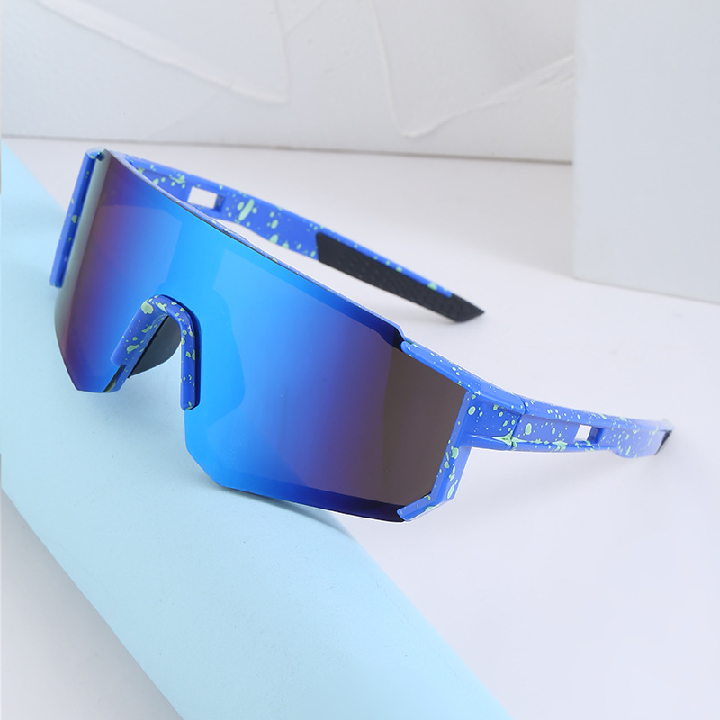
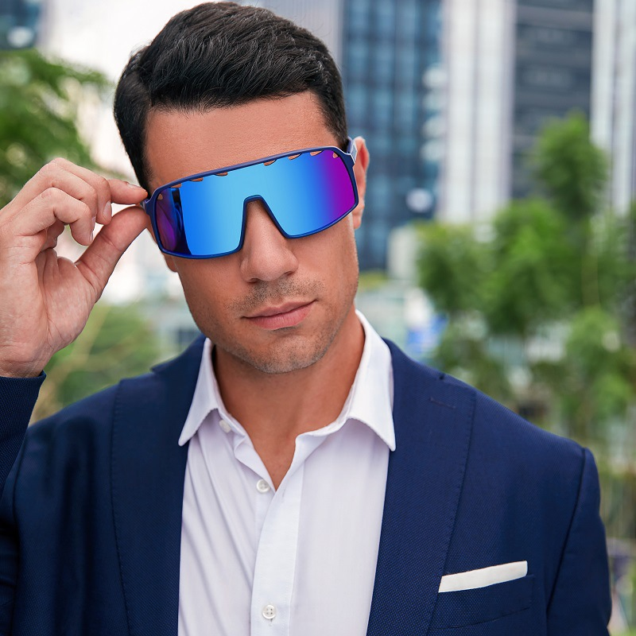
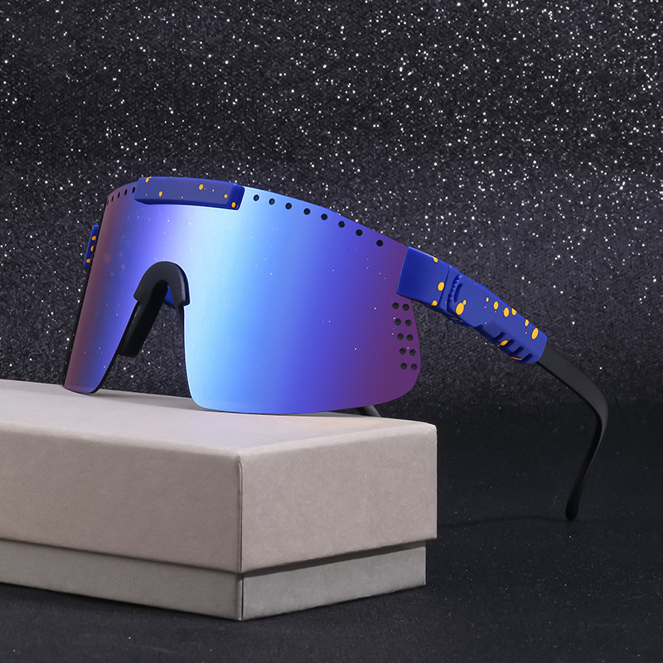
Men’s Glasses
Outdoor Cycling Colorful Sunglasses
Windproof Sports Trendy Glasses
https://www.nihaojewelry.com/men-s-sunglasses
https://www.nihaojewelry.com/es/gafas-de-sol-hombre
NHLMO529300
NHLMO425029
NHLMO408235

Slide 3
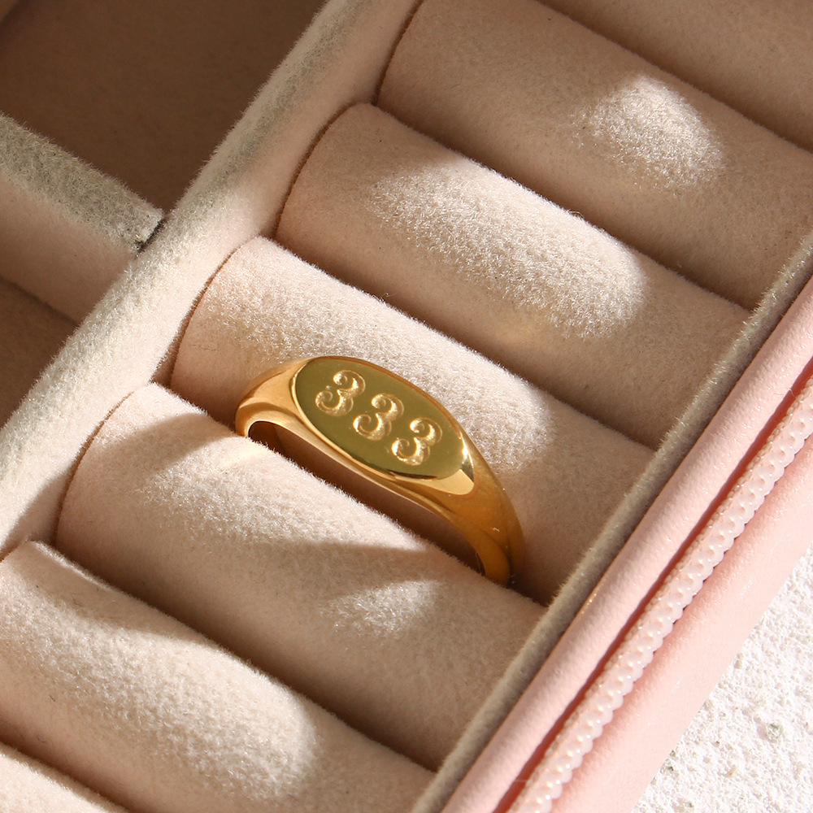
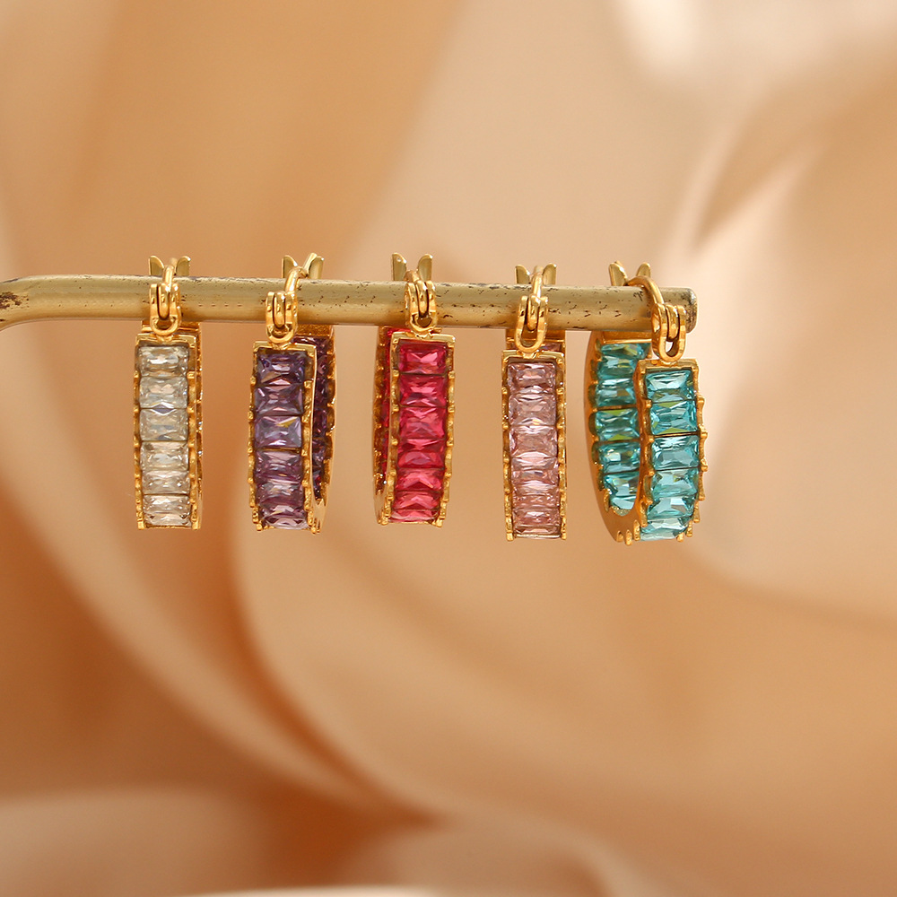
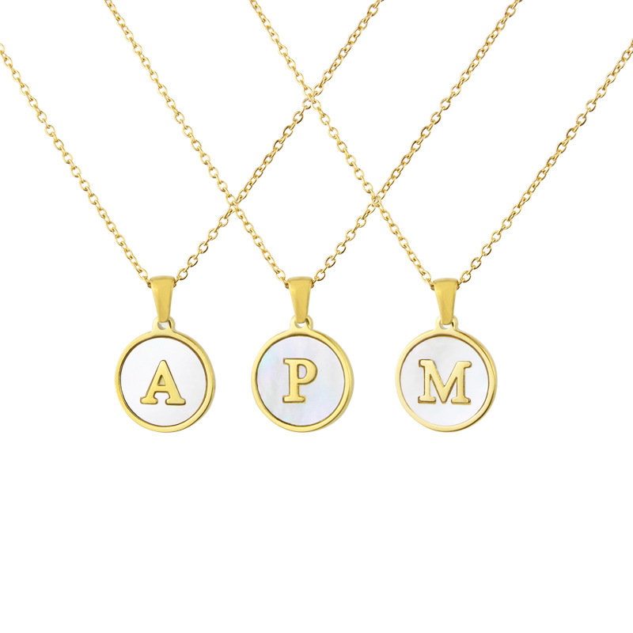
Stainless Steel
a longer lifespan for its inherent corrosion and scratch-resistance. better for everyday use, especially for jewellery.
https://www.nihaojewelry.com/stainless-stainless-jewelry
https://www.nihaojewelry.com/es/joyeria-de-acero-de-inoxidable
NH814666
NH814742
NHBP260775

Slide 4
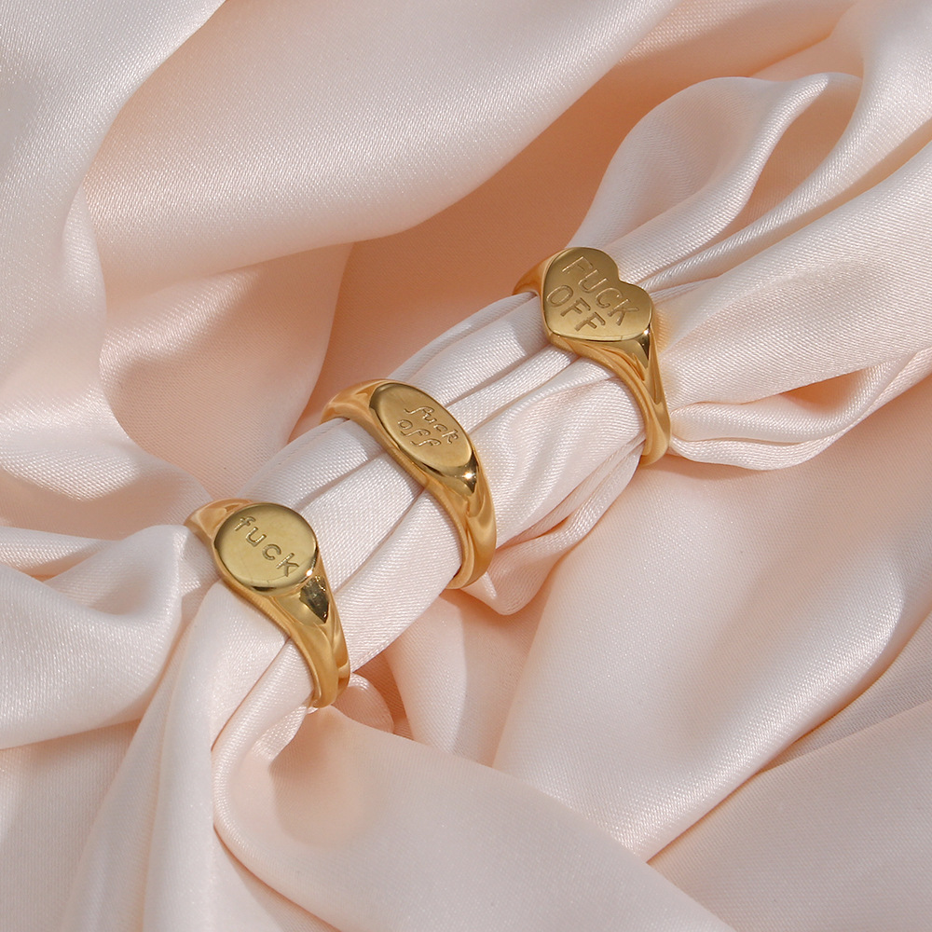
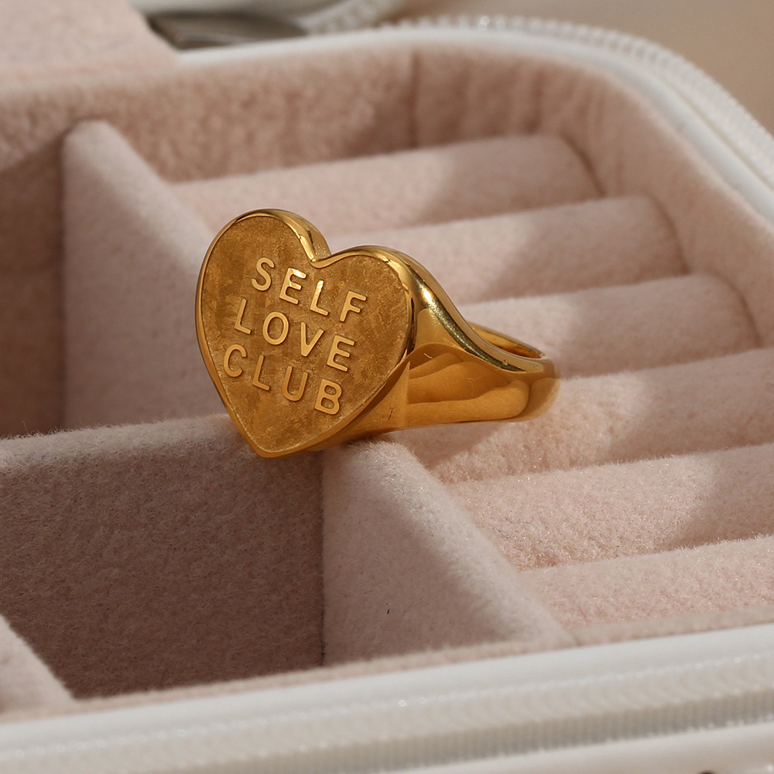
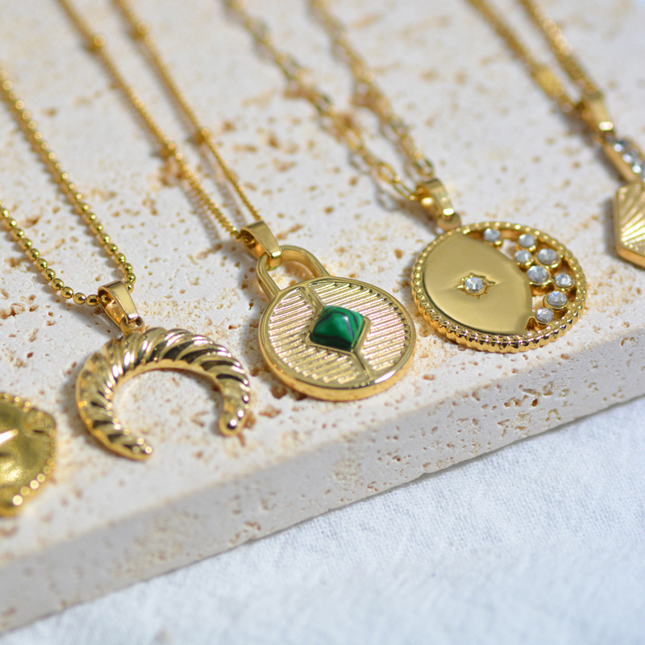
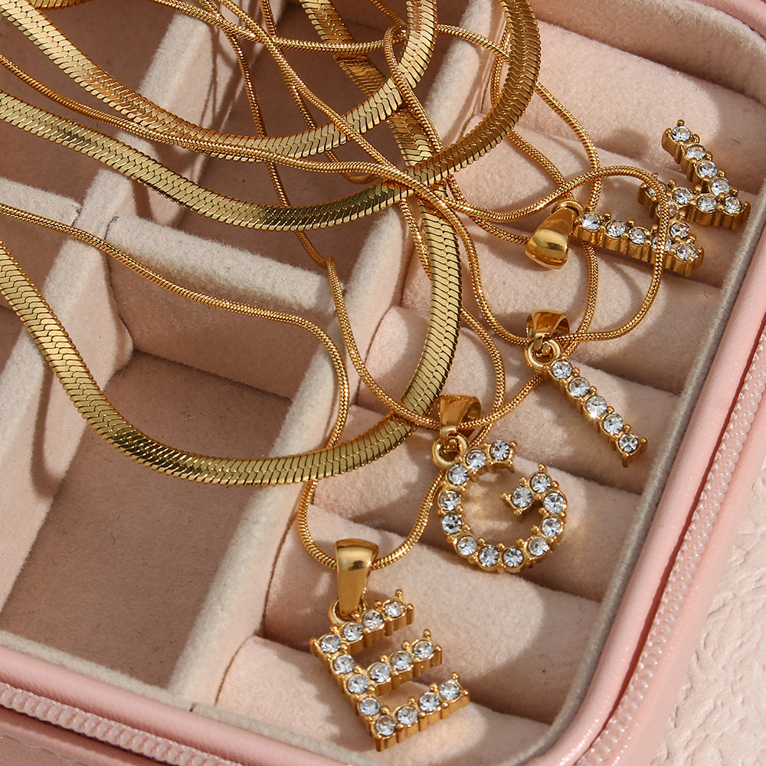
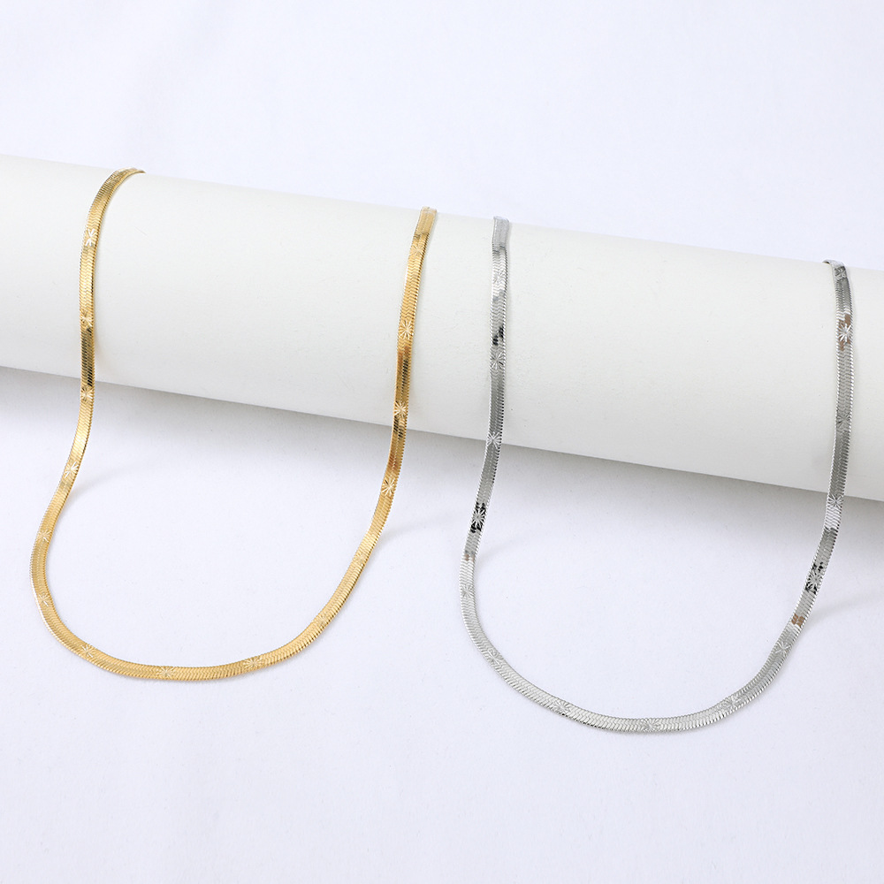
NH819596
NH819595
NHWC695228
NH819625
NH819611
NHYUN387976

Slide 5
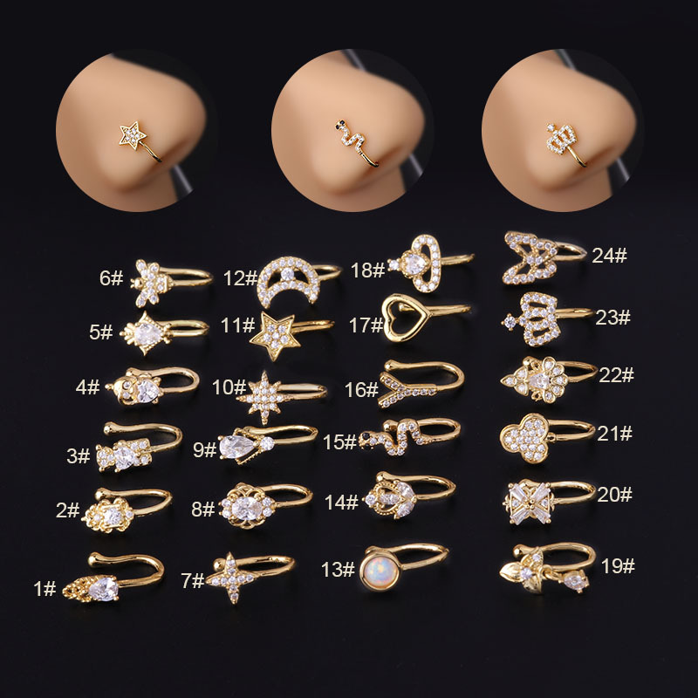
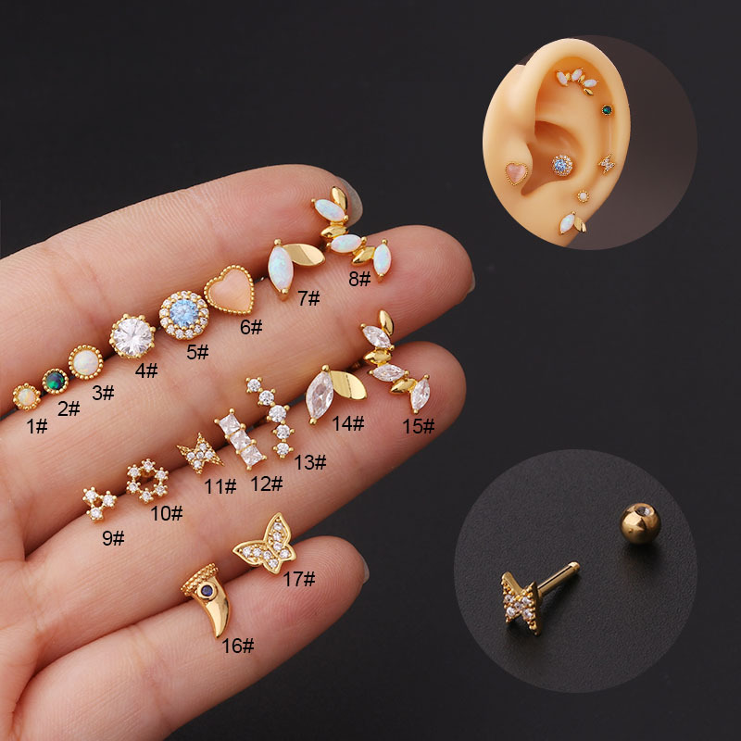
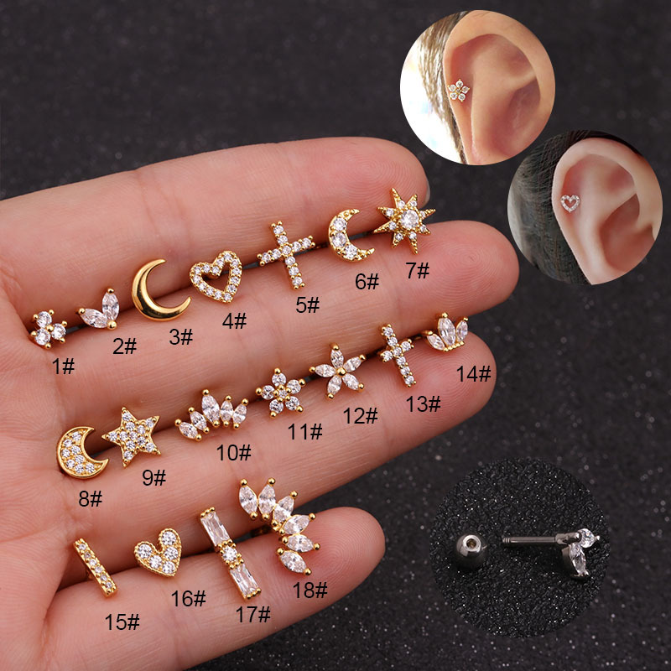
Body Jewelry
Common types of body jewelry that are sold often in modern days include barbells, captive bead rings, labrets, navel curves, plugs, spirals, and various other types of piercing jewelry.
https://www.nihaojewelry.com/body-jewelry
https://www.nihaojewelry.com/es/body-jewelry
NHEN672803
NHEN431782
NHEN253448

Slide 6
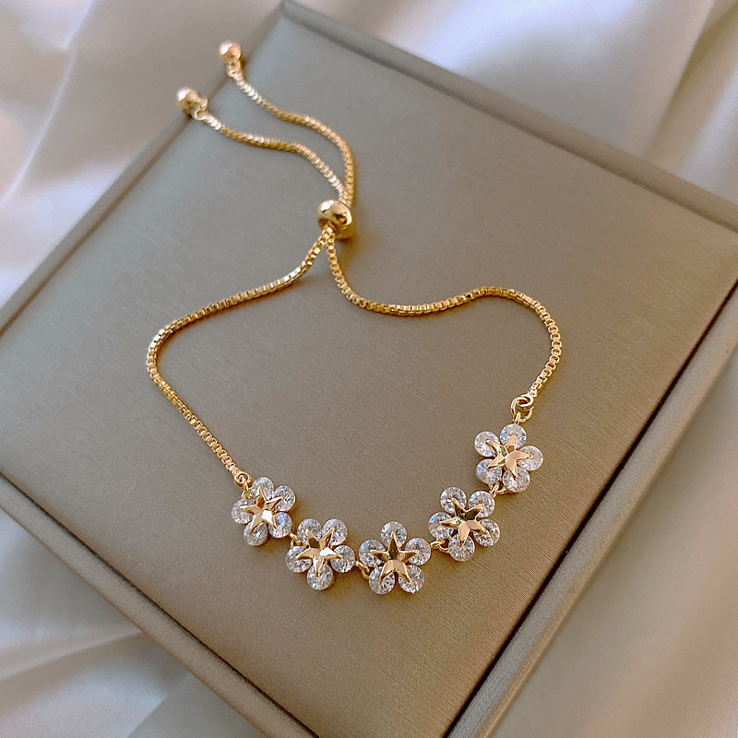
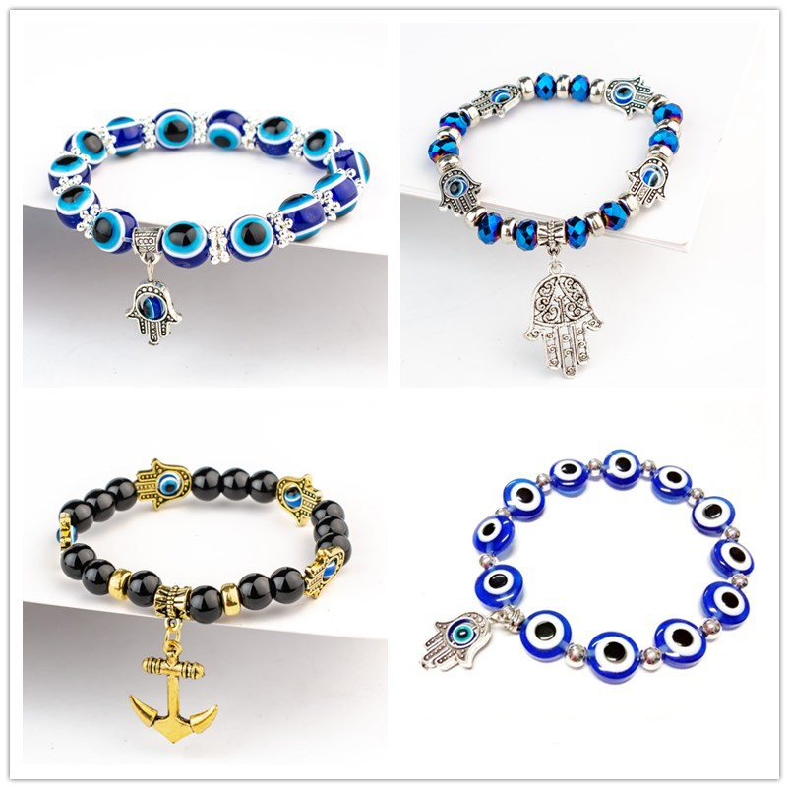
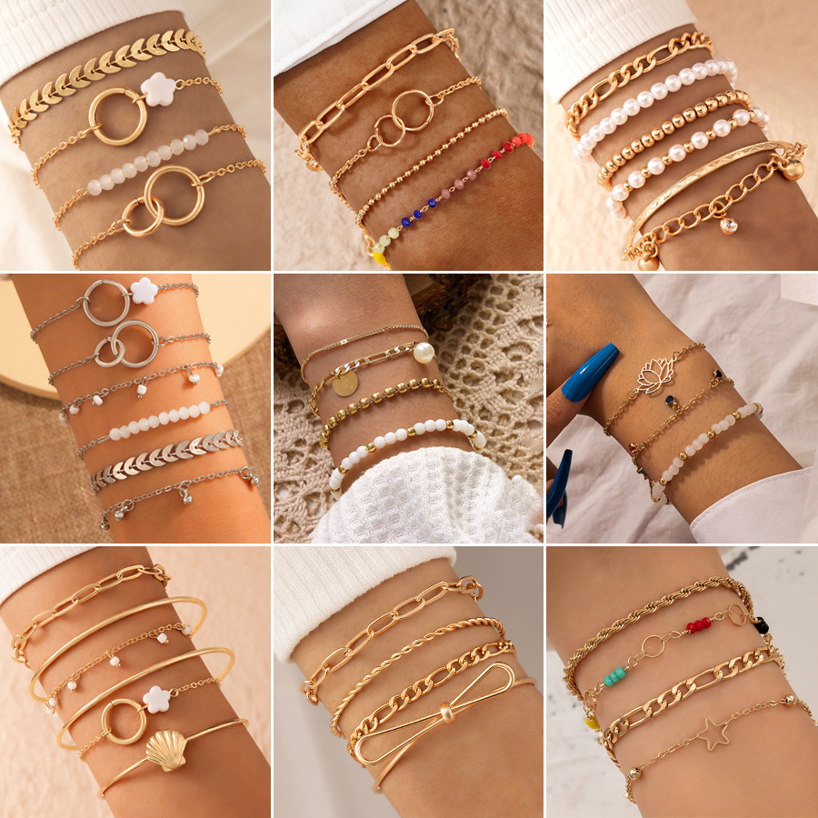
Bracelets & Bangles
Bangles are for more eccentric characters, whereas the bracelets satisfy the most varied tastes.
https://www.nihaojewelry.com/bracelets-bangles
https://www.nihaojewelry.com/es/bracelets-bangles
NHJBY630292
NHDAX644750
NHGY698883

